Slide 1
CIPHER ROGUE
Réalisé par Kévin Angelier-Leplan
Supervisé par Élodie Desserée

Slide 2
Entités du jeu
Shooter
Sniper
Player
Bomber
Seeker
Charger
Turret
Spawner
Bullet
Bombshell
Bullet
Bombshell
Bullet
Seeker

Slide 3
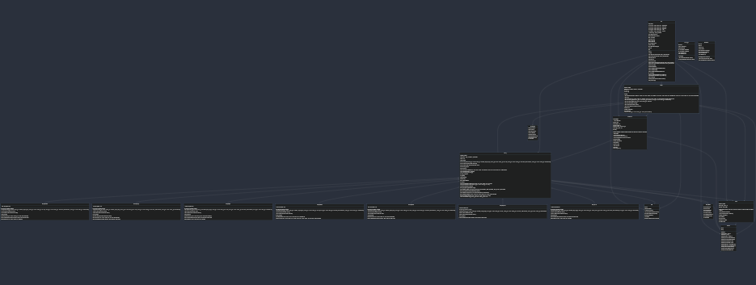
Diagramme des classes

Slide 4
https://mermaid.ink/svg/pako:eNrtW_9v2zYW_1d4KhA4s72Lt8vaBm2AJm2WAQtaNMYV2OVwYCza5iKJmkQl8XLt3z5-1yP1JY6bQ7er9UMs8X3h4-PnPT5Syl00YzGJDqJZgsvyNcWLAqcXGRLXm4ykK_Tiv-Oxvj1fMsZJ0U48XuJi0UU8z2jeRTti6WWnHCFXnbQc32RdxGlVFIRfZBfZuwSvSIEsQTb9iFMiGg6RpoEGw-KeP-AkAY9HVZJIrXWDsL1cEo_pHSsppyyTPWmzak31s1VVt9RydZseKMe8lNpcb2A0sM3vW_fQaAYesVaBBmsWbHI9uOZAKWDWt85iPTkKWUg66M6w5vpHk-U1RKXAD4n_k_PiBbomM87Eb5XR3yqi2rRhh4eH6FLdlWb8myt4lSQPkrduUCrsQ_kADdLZUvgGP0xOjVQKEnFDiSdq2Ute0GxxiFJSlnhBpqRIaYaTmnWsOVBMS-X8-ExzAo55wjBvMExpaoMMcM2qomRFSKuyki4yEiOacZSQawINuGQsMXL_pCW9TEhIVBICOwUnMaBJZcRF_DErOSDGrBKaxPiFlDQnkEtxfk4S4SQB1FNaCl-t_jXZ-zfgmpJbjrj4A9pOmBAF6JSeVpfE8GAXEizFXJ9aOAIWc10zGqMqjzEnA_SeZDEpPtAsZjc76Eb9jpCZEJJwLIcWaG1XC7XHBb7ZUHevcnOpOaOlDunXBMeDXRSqWUcPNJlmlP8sYdCm6wHKzOVw-Gq2pOLXNxHMuPPXCb5y0bOp78a1-491nDySQiKCmK1kHikHu033wLHoJHfMkkTEGst6-IV2MAGzJZld6VxZOukPlC9d_utT5XR1qXz79qhPPJTvUCNTtzNON6kk2au6QzdASqkyxRnO-_X0K4Im5xWXk3VSsHTKBnbBRHPxPHLrJ-Ksv7u1-oPdzmmSPEa_D-nYm6mCiKx2vx836sFLcHqtUstQe2zda8DmFkBDSrkyeRD86Bc_1ul3YPHWUX-LGk0rZIWHVs6qdQ1oYMRt9lg1OSSmBV3-rGzeA2SzdAoOc-dU1BhhomzHYtUcOhTtIMaXpOhmHXexNji_MWMoZzjB3Wx_b2VDoBdr5MsBQvfZWbOPe9jV2mYZX67L-Ld1GV908gW4kWEMMDPWeYr-TuDiVc9Bbm8ApqSKQYMDBMbwnmIBspo1_6fM18oufxWZUzxC3tqsBeEhkDWHHI0gnosBDXpEBdvAqy2FXeS23WOnLCW5qFuN13QtN1cFXb3mq6qvKgjilCfEPhjaeV5Qbkjm3r8M33sxZJwtBNMS50TtaY4qzoXRHRy_VZRbDmgIEFWPqGEqEDUcFtbisiN2OWKNAhCySocucRYn5Dihs6tegcDZourjS-jtoPCvvQ8Hk8Kth25SMlNXhYeeS0lW6eHf51m_HysFNLe40_rCjWbQqBt3XUZew7OW8zMc66otuGDUrc14HjWTwFQeyHC7PpQ5IbF7EAE30gW8iOOVF3qf6l68dm_D0lOydnoI7TTzSc375jZPmKzn1hAyWei1qNc4FivXwDl93cSjzW9LPY7ySsLLlzJ7aEGcrnKfZkySlWmzfYlLNbxYbkDa9h-GjXJ7ItXY4avi4ptDyfPGHgM0duVyWs_wbaN9LiZZzhJ6ifYaRC4IU3YiWAT5e0BuwZgPrYYqFZEjCzVpTbjFx-7QJQS8quIh2nVLG9K9zu5Ht7lVu6dqxuXJg6uGPpleQD6EOO9A-bA7wQK81hM0RB2QhCBogNJHSIhLQB2iOiLqMYbazVr7GqdqrVDEvtlGa0wvapvfkedqBKbb1ML1GaGZ7yGYxBMs8Y58gujKtCOfEqvRtNOWBCd82U6b04K8FzPcTtWb53NgTjtDi1nSy4a6ZHqhbgxdjnpo7iXyht2HQRZOI-3kdc84d-wh55py4GxzBxxuridtzjV39MFm8zRDOWEINkp6zP4GSr5aGHyZMXYsnNZuz86CzAi9JjqIfprLOf4iVq9j3CldzzZ7vrxjD5jvV64KJB17rcw95VEX-6mK1m4hFAi6jKfOHZv0zoQbMNZJV4Y74GjJiKiZE20ylPhV5xAjuUSbO0U072E8WbuLE8y5TzFbcZVqtRmep1J2TQaPFpTBGqyAcAd8c00LXuEkKP02wbr33me0gf0bwLgx6NHnBJwHWuiX3q1Aj8yb-Vx0Xz5AtKX-bDJ9csdQ66WuzRLX5l70z_F18gcR6oIuIzfv6rOKdZMR4OypuIbw1Nevt4ZBfjlj17gupoZd2aczodj6srXf09zmm1A1jn-tSmf2ES5J_DYzhf9go5S-Vg_61cJDo3O3mZhbtavD_1ZXqZp2yvTCW2OAg4X4InvSmFlQqj7xdZq0bCtWkJ1hTgZiaq-eu6r2SfCaK9UwgBQdZ53bE29H4u9VgDWAV9s0cpbUawS0YBfaFvrvpOJVoVNtHVAw83rSOvZSYcxyWhWZ2exon7-CBgulGSiG295XhTblWFTeIpOJdBVO5-gRVi-wLCK7w_6ZZuTt_Jwulvzzu_R6sOxW6yHC8i31o_QCNgfgaxi4CMt325zOwLcgqqWELAgKtx72DlvfO2_X8o3r1f7lO5AKF26_svO3QBugqmegQSe2fvwCM9YCdvPN2IZoN9JbuP9V4O6UfcBFJhh-YRnpLH_Hj4Hbxq4n1Cut0e94us5dwhMoMRPHLGEFmsm_u3oXpUs4gGz94eIW2F9VHv8rINVHqf6g9042b4G6BeqfBqgdpdHDwaNQj0LYq6_Rt6jfov7_GfUh6PW_S2xR_zWi_n9RPOh_sdmWuFs0_TlyXZjvFP6-jg8MolGUkiLFNI4OIjXki4gvSUouogNxG-Pi6iLSfLji7HyVzaKDOU5KMop0fJn_-3OtJKai1zPzn4Esm9OFEM5xFh3cRbfRwXjv2z1xTZ5-93x_Mpl8P3n-_Nlkf7I_ilbRweQfe99Onu_98N2zvf3J0_2nzz6Oot8ZE9onSscv6l719PEPE7PUbA

Slide 5
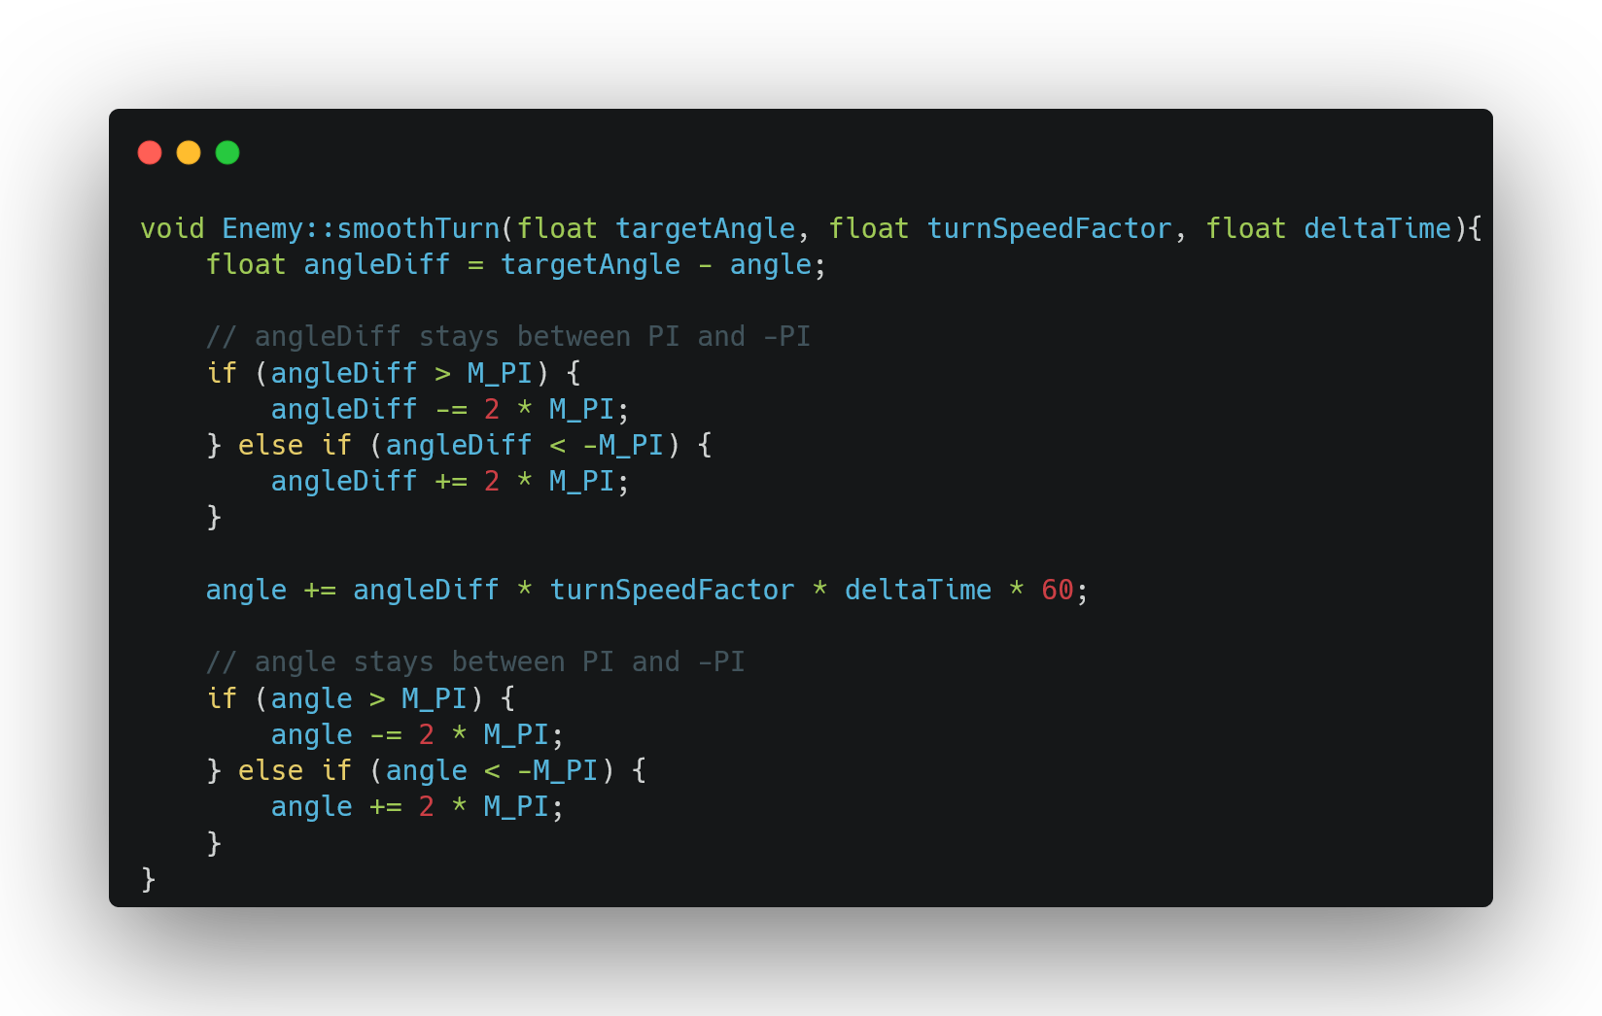
Enemy

Slide 6
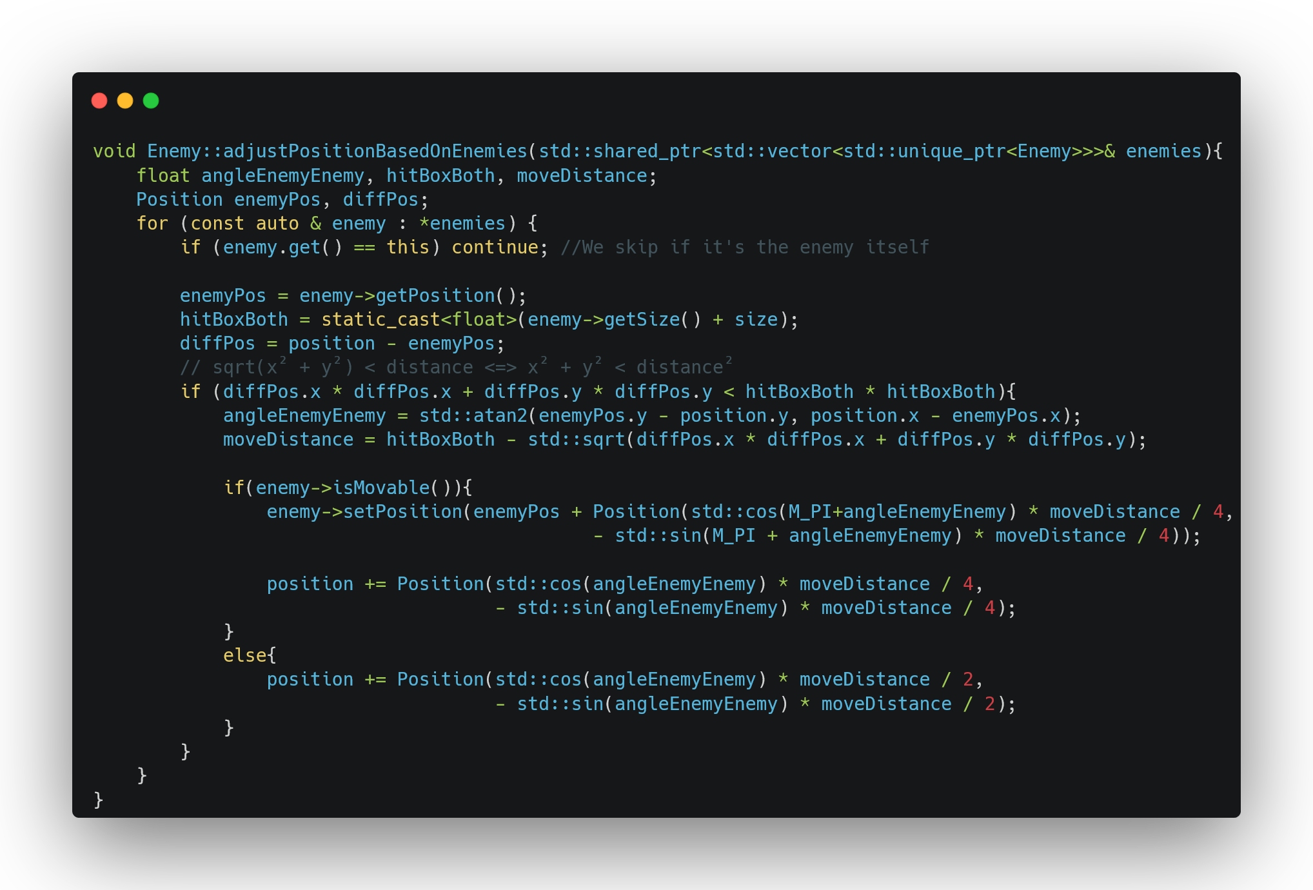
Enemy

Slide 7
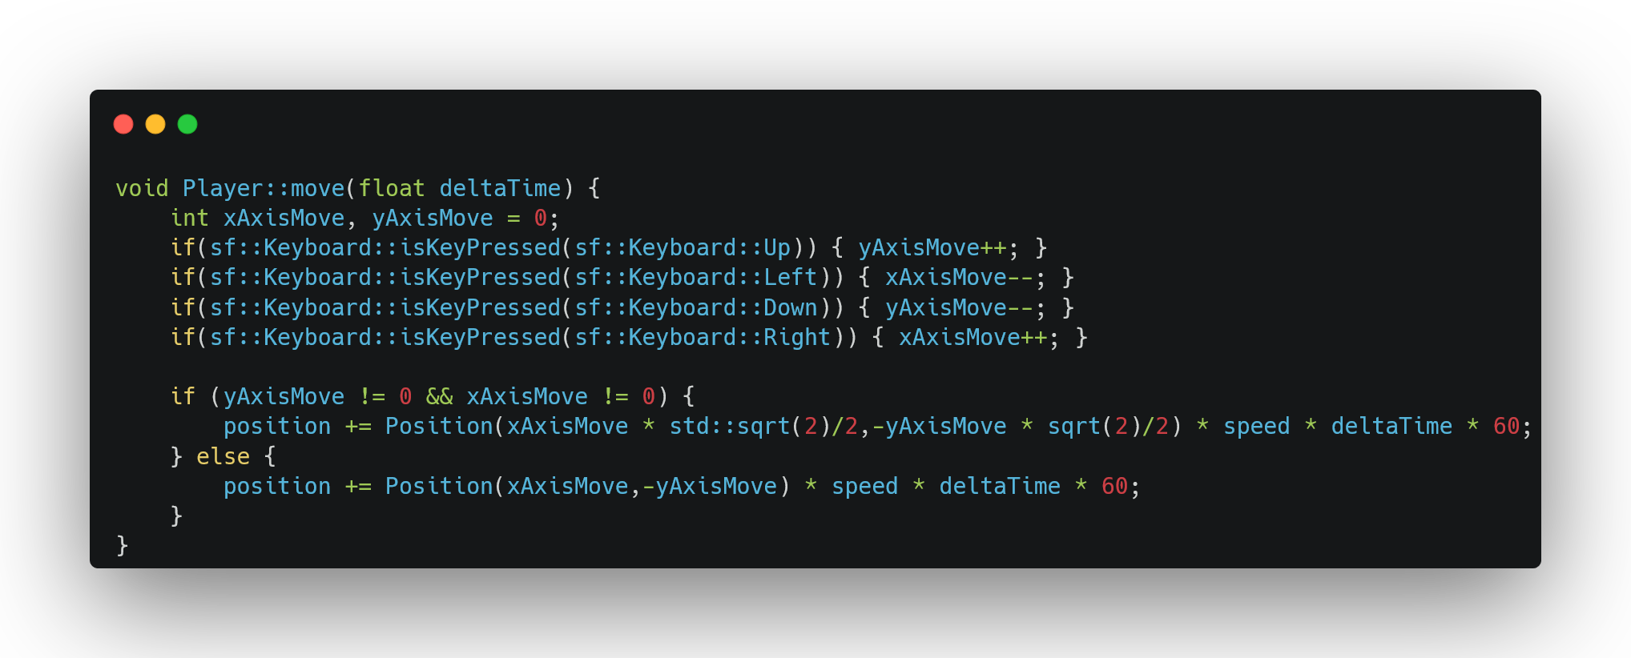
Player

Slide 8
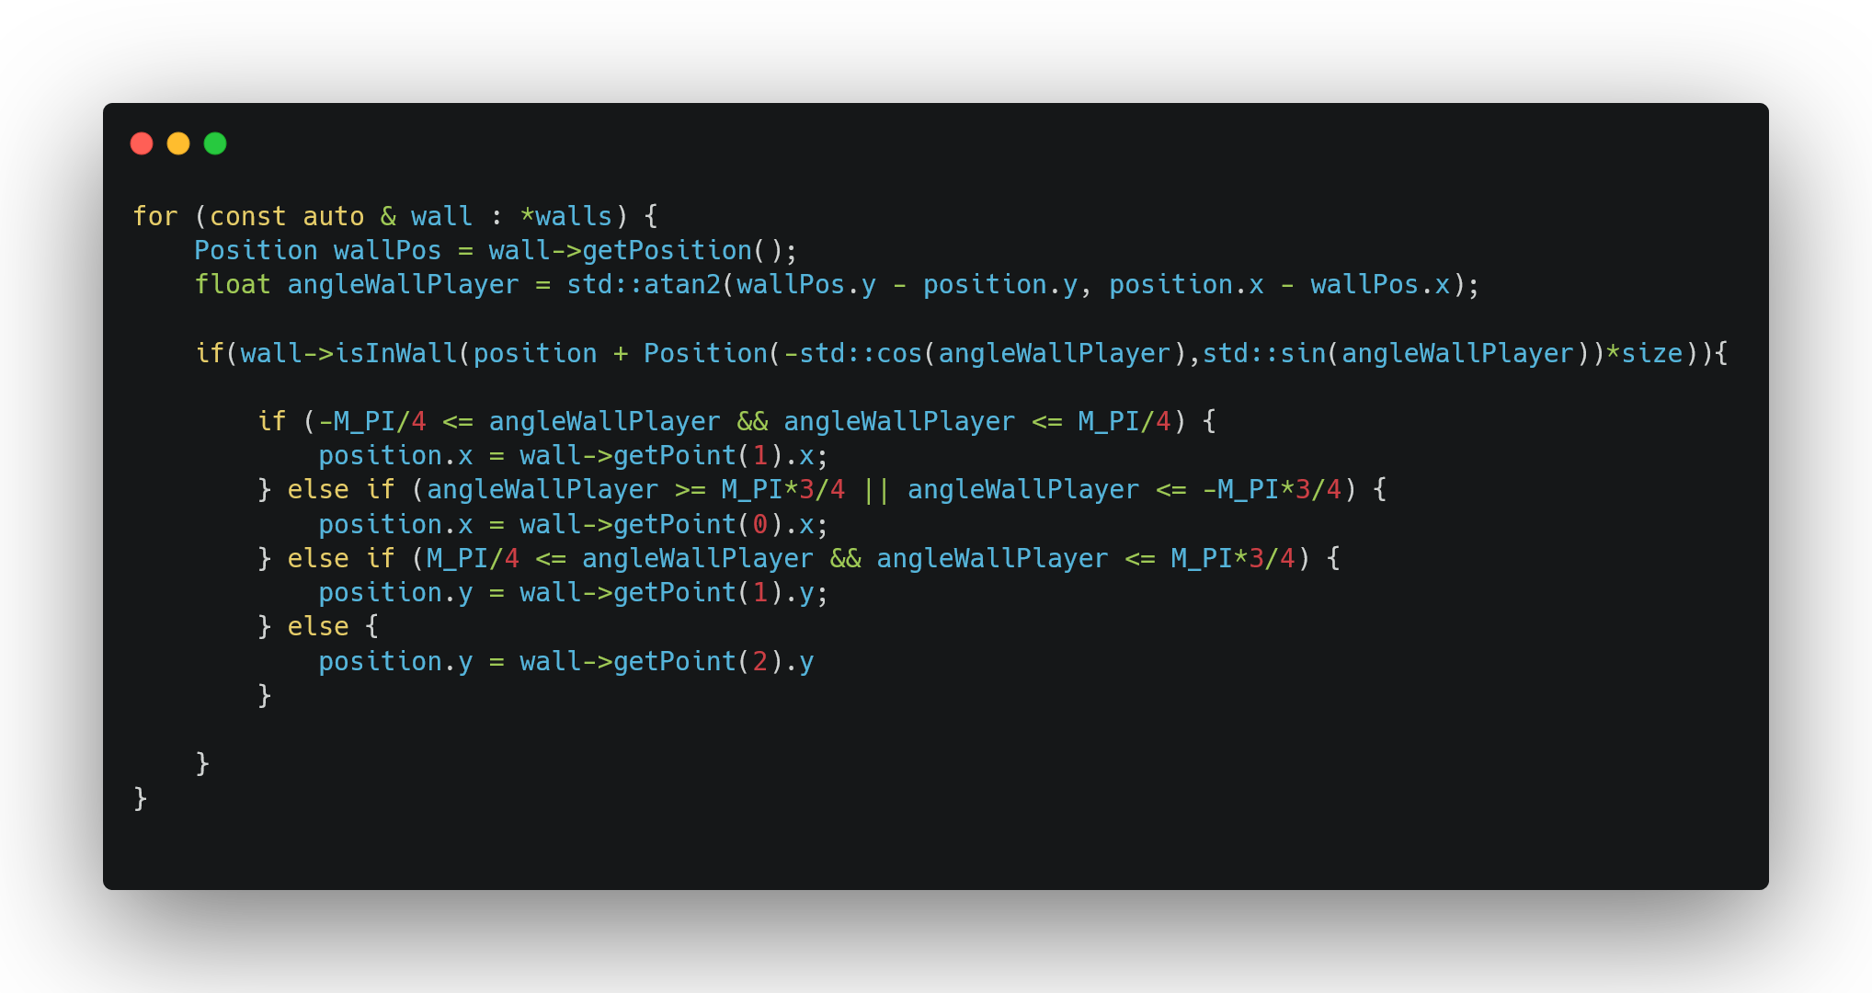
Player & Enemy

Slide 9
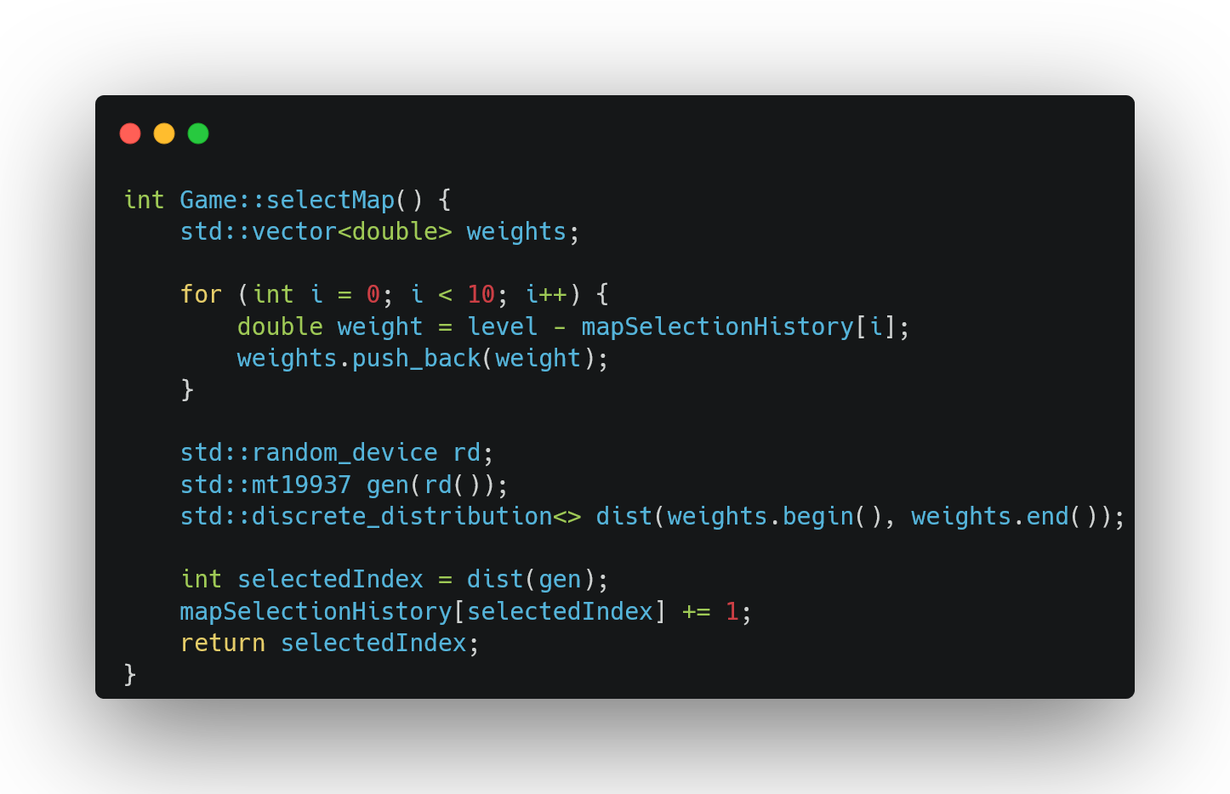
Game

Slide 10
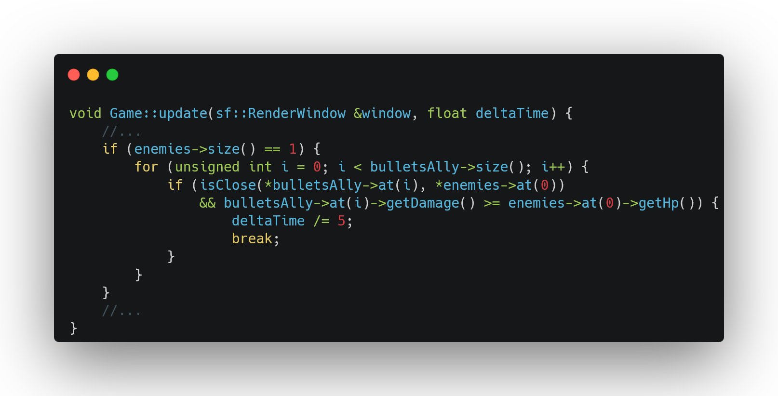
Game

Slide 11
conclusion
Défis :
Collisions entre les ennemis et avec les murs
Gestion de la mémoire
Amélioration :
Plus de type d’ennemis
Plus de type de projectiles
Plus d’obstacles
Des améliorations entre chaque niveau
Des boss
Effets visuels
Meilleure gestion des déplacements

